Slide 1

Joy of Painting Database Model
Lisa Over CMPINF 2110 March 10, 2021

Slide 2
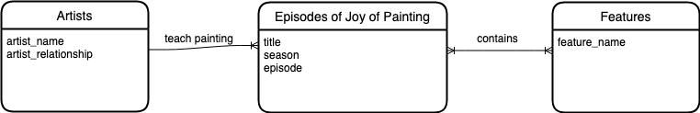

Conceptual Diagram for ross_db

Slide 3
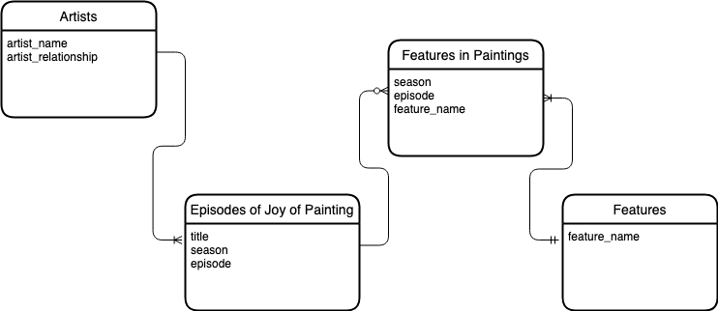
Logical Diagram for ross_db

Slide 4
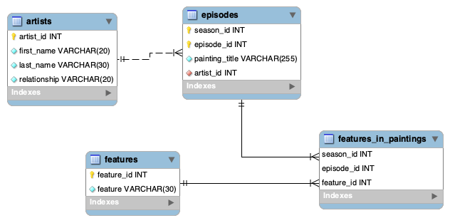
Physical Diagram for ross_db

Slide 5

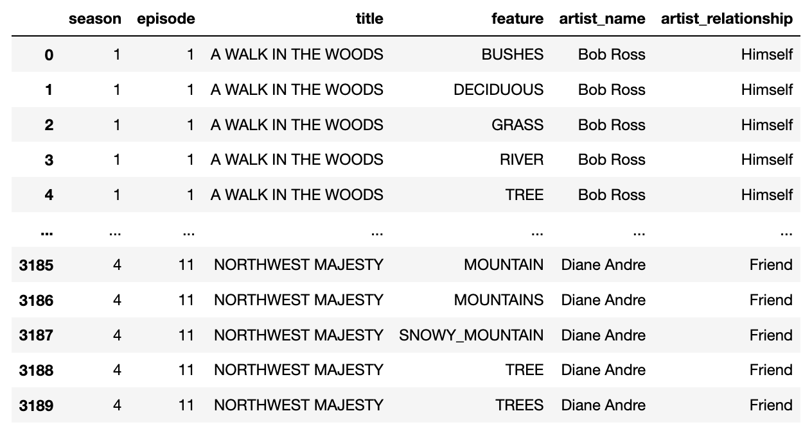
First Normal Form
Tidy data meet 1NF criteria…
The data is in a two-dimensional table
There are no repeating groups – no column has more than one value
The data was also in 1NF when the feature names were columns, because each column only had one value. However, that wide format made it difficult to add new or rename features. The wide format also made it more difficult to search the data because one had to include multiple column names in a query rather than searching one column for one or more values in a list.

Slide 6

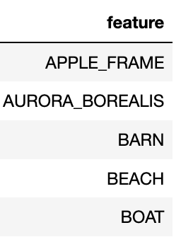
Second Normal Form
The tidy dataset does not meet 2NF criteria. The nonkey element feature is not functionally dependent on the table ID: season and episode. There are numerous features that could be associated with each key.
To meet 2NF criteria, I moved the features column to their own table. Because of the many-to-many relationship between episodes and features, I created the link table features_in_paintings to connect episodes to features. The data now meet 2NF criteria…
The data still meet 1NF criteria
The composite key, season_id and episode_id, determine the title, artist_name, and artist_relationship (there is only one value for each key).

Slide 7
Third Normal Form
The episodes data, even without the features, does not yet meet 3NF criteria. The artist_relationship depends on the artist_name but is not a candidate key.
To meet 3NF criteria, I moved artist_name (as first_name and last_name) and artist_relationship (as relationship) to their own table, artists. Because there is a one-to-many relationship between artists and episodes, I made a connection directly from the new artists table to the episodes table.
The data now meet 3NF criteria because…
The data still meets 2NF criteria
There are no transitive dependencies - there are no columns in any table that depend on anything other than their primary key(s)

